Slide 1
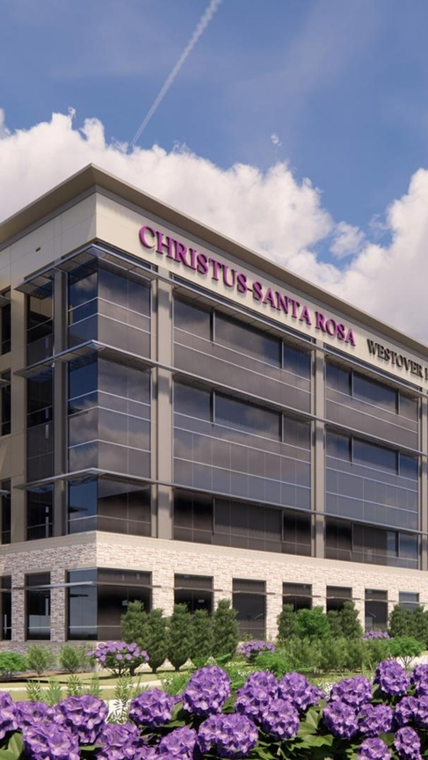


OPPORTUNITY REVIEW
DIRECT-TO-EMPLOYER GTM STRATEGY
Exploring a CHRISTUS Health DTE Health Plan

Slide 2


Founded in 1979, headquartered in Indianapolis
Largest Independently-Owned Full-Service Third-Party Administrator
Specialize in Administration of Self-Funded Plans and Population Health Management​
Leader in the Direct-to-Employer Movement
We Know and Understand the Market
Experience Working with All Professional Teams: Agents, Networks, MGAs
The Key Family of Companies is a Vertically Integrated group of benefit related organizations
3,000+ Corporate Clients
3 Million Members under Management
700 Employees

Slide 3
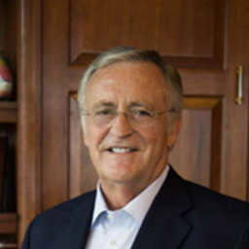


Our Founding and Heritage: 46 Years of Striving for Honesty in Healthcare

Slide 4
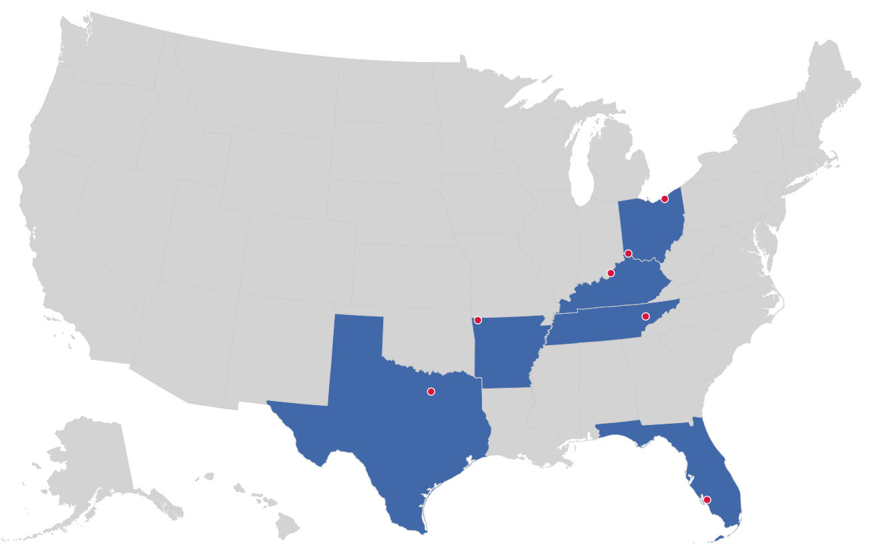

MARKET LEADER
IN
PRIVATE LABELED
DTE PLANS
Cleveland, OH
Louisville, KY
Cincinnati, OH
Bentonville, AR
Knoxville, TN
Dallas Fort Worth, TX
Fort Myers, FL

Slide 5


DIRECT-TO-EMPLOYER (DTE)
YOU Pick the Name of the Health Plan
YOU Determine the Fees Charged
YOU Practice the Medicine
YOU Receive the Profits
WE Make it Successful
Your Health Plan Focused on a Direct Relationship with Self-Funded Employers in Your Market

Slide 6

Direct-to-Employer Strategy: POWERFUL EMPLOYER VALUE
Reduced medical spend through lower unit costs and better integrated care
“At the table” with CHRISTUS Health
Aligned financial incentives
Complete transparency for unlimited visibility into health benefit plan expenses and cost drivers
Aggressive stop-loss premiums and policy terms
Increased employee satisfaction
Improved cash flow & stabilization of future medical cost trend

Slide 7




KBA PLAN GROWTH IN THE FIRST TWO YEARS
1,600 Lives
6,400 Lives
1,800 Lives
12,900 Lives
An average of 25 employer groups in plan within the first two years!

Slide 8
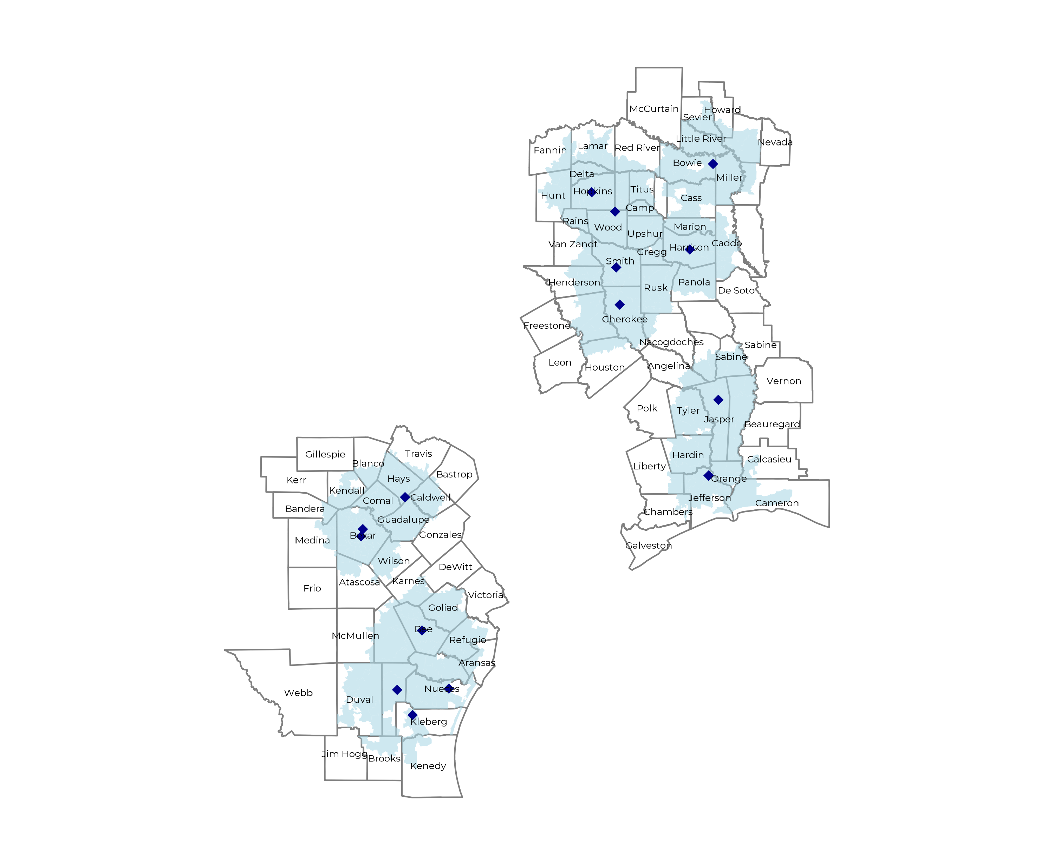
SIGNIFICANT OPPORTUNITY FOR PLAN GROWTH Researched for the below highlighted service area
Target Market 3,800+ Employers 830,000+ Employees 1.5M+ Members
 | Employer Size Group (# of Employees)
Commercial Employers With Headquarters | 50-100 | 101-200 | 201-400 | 401-1,000 | 1,001-3,000 | 3,000+
In Catchment Area | 2,016 | 900 | 543 | 308 | 86 | 58
Total Employees at Employers | 50-100 | 101-200 | 201-400 | 401-1,000 | 1,001-3,000 | 3,000+
Headquartered in Catchment Area | 151,200 | 135,000 | 162,900 | 215,600 | 172,000 | 348,000
Total Members with Employers | 50-100 | 101-200 | 201-400 | 401-1,000 | 1,001-3,000 | 3,000+
Headquartered in Catchment Area | 272,200 | 243,000 | 293,200 | 388,100 | 309,600 | 626,400

Slide 9
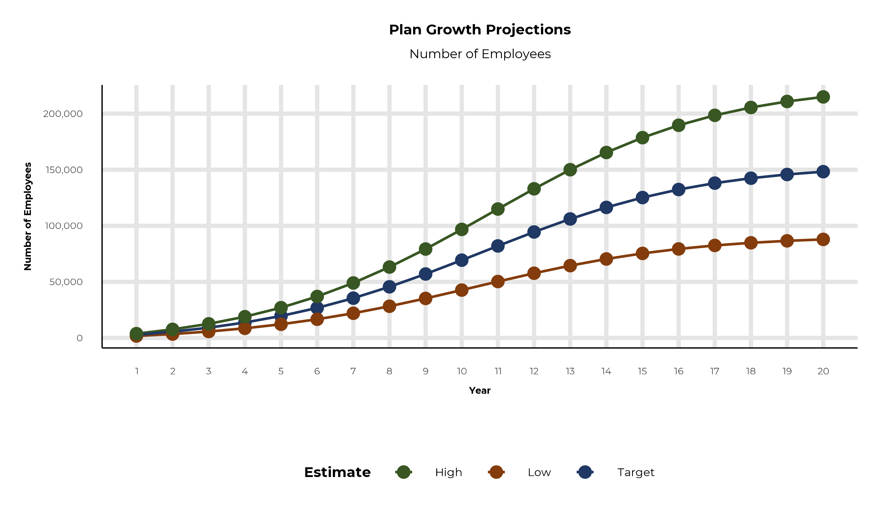
PLAN POTENTIAL GROWTH PATHS
Self Funded
1,016K
Insured
1,819K
Working Age
2,963K
Population
5,137K
Estimates includes the CHRISTUS Health service area in Hempstead, Howard, Lafayette, Little River, Miller, Sevier, Caddo, Calcasieu, Cameron, Anderson, Angelina, Aransas, Atascosa, Bandera, Bee, Bexar, Blanco, Bowie, Brooks, Caldwell, Camp, Cass, Chambers, Cherokee, Comal, Delta, Duval, Fannin, Franklin, Goliad, Gregg, Guadalupe, Hardin, Harrison, Hays, Henderson, Hopkins, Houston, Hunt, Jasper, Jefferson, Jim Wells, Karnes, Kendall, Kenedy, Kleberg, Lamar, Liberty, Live Oak, Marion, Medina, Morris, Nacogdoches, Newton, Nueces, Orange, Panola, Rains, Red River, Refugio, Rusk, Sabine, San Augustine, San Patricio, Smith, Titus, Travis, Tyler, Upshur, Van Zandt, Wilson, and Wood Counties

Slide 10
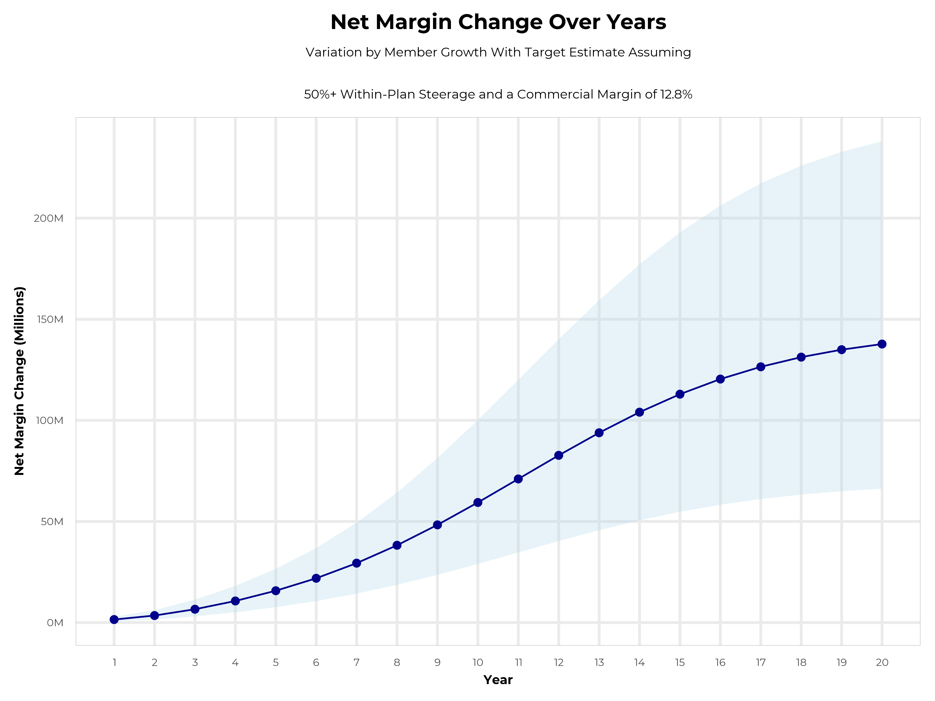
GROWING POWERFUL, LASTING PROFITABILITY
Early Stage
Gaining Name Recognition, Early Growth
New Revenue:
New Profit:
$77.15M
$9.98M
Growth Stage
Strong Reputation, Strong Growth
New Revenue:
New Profit:
$460.23M
$60.41M
Mature Stage
High Profitability, Market Saturation
New Revenue:
New Profit:
$944.52M
$123.97M

Slide 11
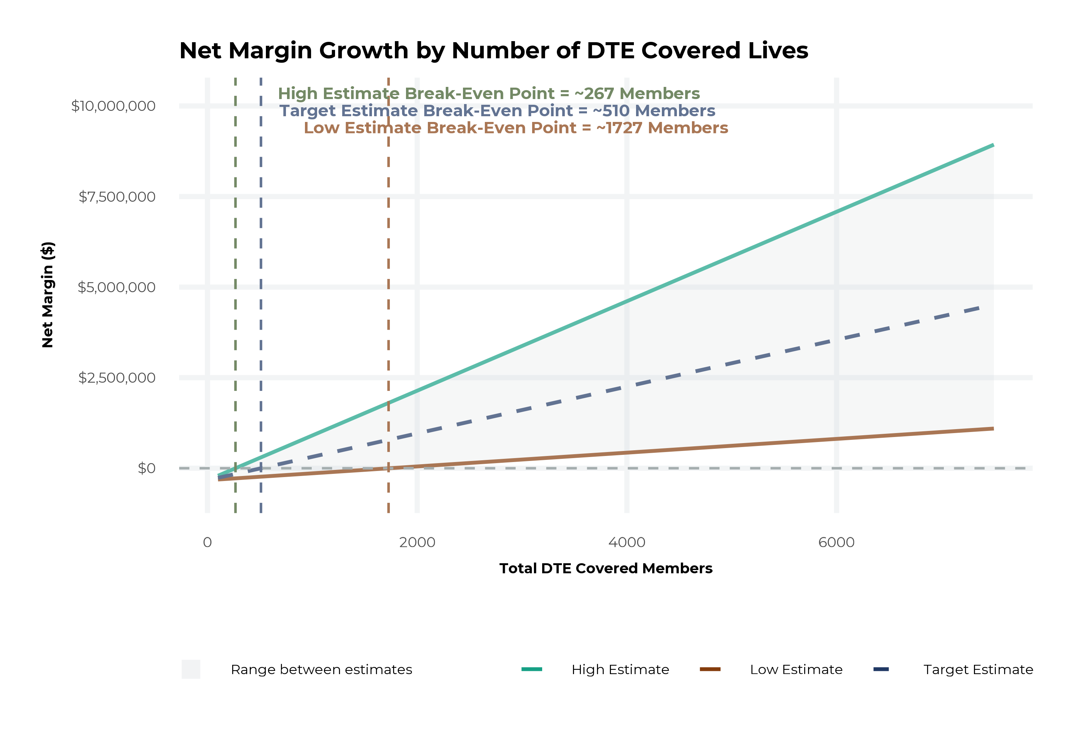
MODEL ASSUMPTIONS AND BREAK EVEN
Patient Steerage Assumptions
KBA currently estimates that CHRISTUS Health has 18% inpatient market share, and 15% outpatient market compared to hospitals/clinics in the CHRISTUS Health service area (see slide 8). The DTE tiered structure will create immediate steerage, with additional steerage over time from patient bonus benefits and the patient convenience card (see slide 35 for estimates of target steerage).
Low
High
10% below target
10% above target
Commercial Margin Assumptions
KBA observes a CHRISTUS Health 16% commercial margin. Conservatively, we model the DTE to be even with commercial rates given prices 10% below market, but with a 10 percentage-point increase through friendlier billing practices and improved patient collections with the patient card.
Low
Target
High
7.8%
12.8%
17.8%

Slide 12
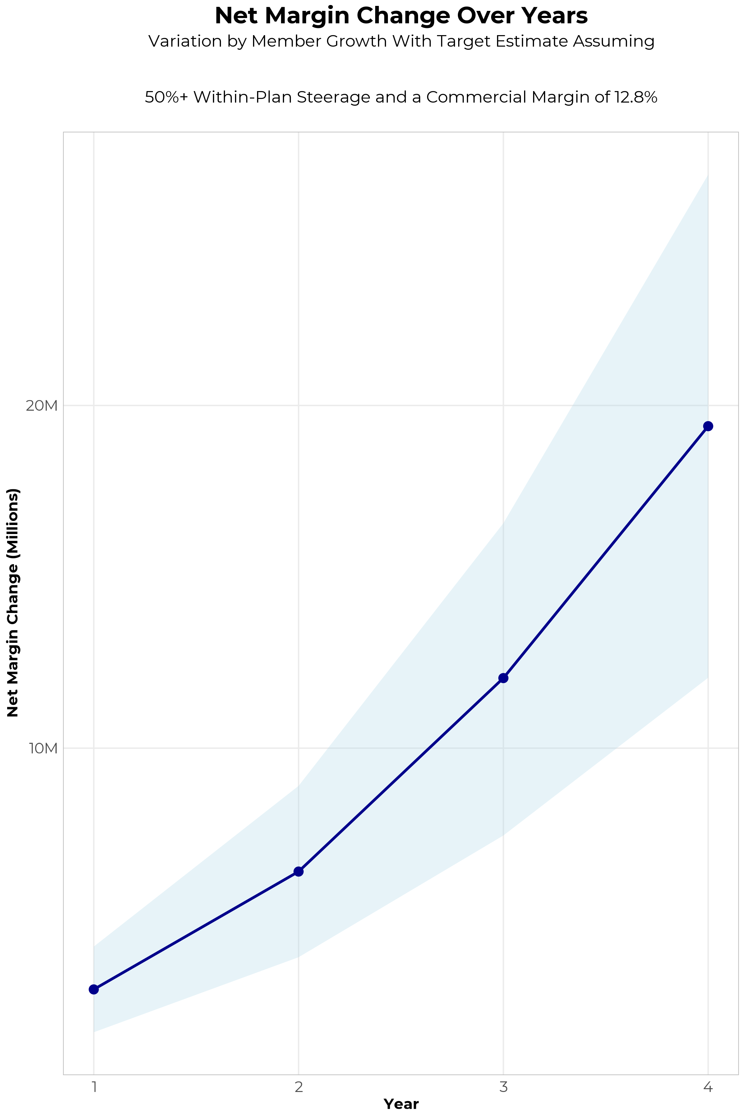
FOUR-YEAR PROJECTIONS
Target Member Growth | Target Member Growth | Target Member Growth | Target Member Growth | Target Member Growth
Metric | Year 1 | Year 2 | Year 3 | Year 4
Number of Members | 5,000 | 10,000 | 16,500 | 24,800
Incremental Margin | 3,229.4K | 6,458.8K | 12,026.6K | 19,278.0K
Network Access Fee | 60.0K | 120.0K | 198.0K | 297.6K
Implementation Fee (One-Time) | -150.0K | 0.0K | 0.0K | 0.0K
Sales and Marketing Costs | -180.0K | -180.0K | -180.0K | -180.0K
Net Margin Change | 2,959.4K | 6,398.8K | 12,044.6K | 19,395.6K
High Member Growth | High Member Growth | High Member Growth | High Member Growth | High Member Growth
Metric | Year 1 | Year 2 | Year 3 | Year 4
Number of Members | 6,900 | 13,800 | 22,600 | 34,100
Incremental Margin | 4,456.6K | 8,913.2K | 16,472.8K | 26,507.2K
Network Access Fee | 82.8K | 165.6K | 271.2K | 409.2K
Implementation Fee (One-Time) | -150.0K | 0.0K | 0.0K | 0.0K
Sales and Marketing Costs | -180.0K | -180.0K | -180.0K | -180.0K
Net Margin Change | 4,209.4K | 8,898.8K | 16,564.0K | 26,736.4K
Low Member Growth | Low Member Growth | Low Member Growth | Low Member Growth | Low Member Growth
Metric | Year 1 | Year 2 | Year 3 | Year 4
Number of Members | 3,100 | 6,200 | 10,300 | 15,500
Incremental Margin | 2,002.2K | 4,004.5K | 7,507.5K | 12,048.7K
Network Access Fee | 37.2K | 74.4K | 123.6K | 186.0K
Implementation Fee (One-Time) | -150.0K | 0.0K | 0.0K | 0.0K
Sales and Marketing Costs | -180.0K | -180.0K | -180.0K | -180.0K
Net Margin Change | 1,709.4K | 3,898.9K | 7,451.1K | 12,054.7K

Slide 13
DIRECT-TO-EMPLOYER STRATEGY: ONLY AVAILABLE TO PREMIER HEALTH SYSTEMS
STRONG Brand Quality
EXTENSIVE Patient Access
AFFORDABLE Value Pricing
EXCELLENT Care Quality

Slide 14
CHRISTUS HEALTH IS PATIENT RECOMMENDED
Health System | HCAHPS Recommendation Percentile | CMS Stars Percentile | Mortality Percentile | Readmission Percentile | KBA Brand Quality Score
Community Hospital Corporation | 63 | 31 | 73 | 48 | 66
University Health | 56 | 63 | 74 | 56 | 66
Community Health Systems | 56 | 63 | 82 | 67 | 65
CHRISTUS Health | 52 | 76 | 70 | 65 | 64
Department of Veterans Affairs | 56 | 100 | 61 | 57 | 63
Ardent | 51 | 33 | 71 | 56 | 61
Other Independent Hospitals | 49 | 51 | 61 | 56 | 61
HCA Healthcare | 45 | 71 | 89 | 54 | 60
Ascension Health | 48 | 100 | 81 | 71 | 60
Tenet Healthcare | 27 | 63 | 69 | 81 | 53
ScionHealth | 16 | 31 | 61 | 56 | 51
Healthcare Systems of America | 10 | 63 | 63 | 62 | 48
LifePoint Health | 6 | 8 | 64 | 55 | 46
Based on quality measures and HCAHPS feedback, KBA estimates that CHRISTUS Health has the strongest brand quality in Hempstead, Howard, Lafayette, Little River, Miller, Sevier, Caddo, Calcasieu, Cameron, Anderson, Angelina, Aransas, Atascosa, Bandera, Bee, Bexar, Blanco, Bowie, Brooks, Caldwell, Camp, Cass, Chambers, Cherokee, Comal, Delta, Duval, Fannin, Franklin, Goliad, Gregg, Guadalupe, Hardin, Harrison, Hays, Henderson, Hopkins, Houston, Hunt, Jasper, Jefferson, Jim Wells, Karnes, Kendall, Kenedy, Kleberg, Lamar, Liberty, Live Oak, Marion, Medina, Morris, Nacogdoches, Newton, Nueces, Orange, Panola, Rains, Red River, Refugio, Rusk, Sabine, San Augustine, San Patricio, Smith, Titus, Travis, Tyler, Upshur, Van Zandt, Wilson, and Wood Counties.

Slide 15
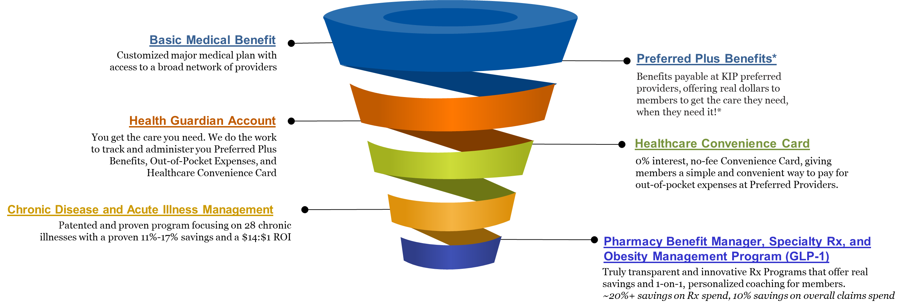
The Key Incentive Plan
Affordability Without Compromise
The Key Incentive Plan is a one-of-a-kind solution, empowering employers to take back control of their healthcare programs, that offers freedom of choice when choosing providers in your local community, while incenting members to choose high-quality, cost-effective care.
*Daily Inpatient Hospital Benefit, OP Surgery/Anasthesia, OP Radiology/X-Ray, OP Diagnostic Labs, Health Screening Benefit, Wellness Benefit, Critical Illness

Slide 16

Weight Management (GLP-1s) that Don't Break the Bank
The GLP-1 medication market has experienced explosive growth, fundamentally reshaping healthcare spending across America. Prime Therapeutics reports that per-member-per-month spend has tripled by March 2025, with these breakthrough medications now representing approximately 15% of total pharmacy spend. More than 1 in 50 members filed a GLP-1 claim in Q1 2025 alone, demonstrating unprecedented demand for these life-changing treatments.
The Challenge
Our Solution
The Impact
Traditional GLP-1 medications cost between $1,089-$1,349 monthly, creating unsustainable budget pressures for employers while limiting employee access to essential treatments.
Key Benefits secures generic GLP-1 medications for just $249 per month, enabling comprehensive workforce health while maintaining strict budget control and financial stability.
Deliver a healthier population, increased employee satisfaction, and sustainable costs that support long-term organizational success and employee wellbeing.
Proven Results: $7M Annual Savings
270
One major city spending $11 million annually on GLP-1 medications achieved $7 million in cost savings through our comprehensive approach. This dramatic reduction demonstrates how strategic sourcing combined with clinical support creates sustainable, scalable solutions for large employers facing escalating pharmaceutical costs.
Health Conditions
Beyond Medication: Comprehensive Care
Created or exacerbated by obesity according to Cleveland Clinic research
Our program extends far beyond cost-effective medication access. Members receive specialized coaching twice monthly, focusing on maintaining muscular strength, engaging in moderate exercise, and developing sustainable lifestyle changes that support long-term weight maintenance after GLP-1 treatment completion.
$8.5K
Additional Spend
Average annual healthcare costs above normal for obese individuals (KFF)
Transform Your Healthcare Strategy: Join forward-thinking employers who are providing comprehensive weight management solutions while protecting their bottom line. Our approach combines clinical excellence with fiscal responsibility, creating a win-win for organizations and their valued employees.

Slide 17
SINGLE YEAR SUMMARY
DTE Covered Members Financial Analysis | DTE Covered Members Financial Analysis | DTE Covered Members Financial Analysis | DTE Covered Members Financial Analysis | DTE Covered Members Financial Analysis | DTE Covered Members Financial Analysis | DTE Covered Members Financial Analysis | DTE Covered Members Financial Analysis
Target Estimate Assuming 50%+ Within-Plan Steerage and a Commercial Margin of 12.8%. | Target Estimate Assuming 50%+ Within-Plan Steerage and a Commercial Margin of 12.8%. | Target Estimate Assuming 50%+ Within-Plan Steerage and a Commercial Margin of 12.8%. | Target Estimate Assuming 50%+ Within-Plan Steerage and a Commercial Margin of 12.8%. | Target Estimate Assuming 50%+ Within-Plan Steerage and a Commercial Margin of 12.8%. | Target Estimate Assuming 50%+ Within-Plan Steerage and a Commercial Margin of 12.8%. | Target Estimate Assuming 50%+ Within-Plan Steerage and a Commercial Margin of 12.8%. | Target Estimate Assuming 50%+ Within-Plan Steerage and a Commercial Margin of 12.8%.
DTE Members | Pre-DTE Revenue | Pre-DTE Margin | DTE Revenue | DTE Incr. Revenue | DTE Total Margin | DTE Incr. Margin | Net Margin Less DTE Fees
100 | $ 208K | $ 27K | $ 704K | $ 495K | $ 90K | $ 63K | $ -265K
500 | $ 1,042K | $ 133K | $ 3,518K | $ 2,476K | $ 450K | $ 317K | $ -7K
1,000 | $ 2,084K | $ 267K | $ 7,036K | $ 4,952K | $ 901K | $ 634K | $ 316K
2,500 | $ 5,211K | $ 667K | $ 17,591K | $12,381K | $ 2,252K | $ 1,585K | $ 1,285K
10,000 | $20,843K | $2,668K | $ 70,365K | $49,522K | $ 9,007K | $ 6,339K | $ 6,129K
20,000 | $41,685K | $5,336K | $140,730K | $99,044K | $18,013K | $12,678K | $12,588K
NOTE: Please see detailed financial analysis and assumptions used starting on page 28.
Financial projections do not include 340B contribution margin, which could represent $136 PMPM by optimizing 340B through Rx plan design, CHRISTUS Health’s approved site(s) with network integration, and development of CHRISTUS Health’s proprietary PBM program.

Slide 18


INTEGRATION WITH EPIC EHR SYSTEM
KBA shares
evidence-based standards of care for 27 chronic conditions directly into Epic
Hyperthyroidism: Yearly Clinical Evaluation, TSH and T4

Slide 19

THE MISSING PIECE TO VALUE-BASED CARE
Patient engagement is the weak link in delivering value-based care; CHRISTUS Health’s clinical leadership and employer participation can drive better outcomes.
KBA’s proactive care-management team supplements your care-management efforts in outreach to clients.
CHRISTUS Health excels in Standards of Care completion rates for the Chronically Ill, improving care and costs.
Integrating CHRISTUS Health’s managed care with KBA’s programs positions CHRISTUS Health as the value leader.

Slide 20

TRANSPARENT PBM INTEGRATION
Support of CHRISTUS Health’s retail pharmacy(s)
Optimize CHRISTUS Health’s 340B drug
pricing program
Allows CHRISTUS Health to create its own PBM program if desired
Custom telephone number with personalized scripting and separate call tracking & reporting
Fully customizable member welcome booklet & materials
White labeled formulary document and marketing materials
CUSTOM CLIENT SUPPORT:
Specialized call center capabilities
Fully customizable plan designs
Operational access to the platform
Customized process and functions to promote DTE strategy
CLINICAL FLEXIBILITY:
Full portfolio of custom formulary offerings – with optimized formulary shield
Clinical programs that drive towards overall DTE strategy
Options for additional drug savings by driving members to lower cost alternatives
Flexibility to customize or layer on utilization management programs

Slide 21
STOP-LOSS INSURANCE THE KBA EXPERIENCE
Tokio Marine
Nationwide
Berkshire Hathaway
Sun Life
Liberty Mutual
Granular (Google)
Companion Life
Crum & Forster
American Fidelity
RGA
Deep relationships with 20+ stop loss underwriters and carriers
Over $150M in annual stop loss premium placement
Comprehensive pricing and medical service analysis performed for each DTE health plan to ensure proper pricing
KBA provides the administration required of the stop-loss markets:
Bordereau Reporting
Claim Reporting and Reconciliation
Evaluation of Networks
Care Management
Initial Underwriting
Negotiation of rates and terms
Plan Design Actuarial

Slide 22

DTE PROGRAM MARKETING & SALES
KBA WORKS WITH YOU TO MANAGE & SELL:
Branding & Messaging
Direct & Brokerage Sales Distribution – Focused Sales Representative
Brochures, Web Site, Media, etc.
Stop-Loss/Level Funded Down to 20 EE Lives
Sell Through Established Brokers in Your Service Area

Slide 23

COMMUNITY BASED SALES STRATEGY
Locally based sales rep with strong community ties
Collaboration with DTE provider partners to identify strategic employers for early adoption and sales
Work with select broker distribution partners with aligned incentives and goals
Pipeline reporting and collaboration with our DTE provider partners
Marketing and promotion of the new option in the community

Slide 24


Complete Marketing System
Customized Branding and Messaging
Customized Brochures
Customized Web Site
Targeted Employer Outreach
Sales System (Social Media, Email, Text, etc.)

Slide 25
The Key Incentive Plan
Base Medical + Preferred Plus Benefits = Your Deductible Can Simply Vanish
Example: Member with a $2,500 deductible / $4,500 max out-of-pocket has a heart attack and cardiac surgery, resulting in a 5-day in-patient stay. In this example, the member would have a $4,500 OOP with $5,050 Preferred Plus Benefits for a net OOP $0 due to the preferred provider versus $4,500 OOP exposure at any non-preferred provider.
BASE MEDICAL BENEFITS* |  |  | PREFERRED PLUS BENEFITS
Deductible |  |  | Benefits automatically included in your plan!
Single | $2,500 |  |  | Preferred Provider | Non-Preferred Provider
Family | $4,500 |  | OP Radiology/X-Ray | $200 | $0
Coinsurance |  |  | OP Diagnostic Labs | $100 | $0
80% / 20% |  |  | Preferred Hospital Stay ($500/day, 5 days) | $2,500 | $0
Maximum Out-of-Pocket |  |  | Critical Illness Benefit | $2,000 | $0
Single | $4,500 |  | Health Screening Benefit | $125 | $0
Family | $9,000 |  | Total Employee OOP | $4,500 | $4,500
Chronic Disease Management Regimens of Care Covered at 100% |  |  | Preferred Plus Benefits | $4,925 | $0
Healthcare Convience Card to Cover Out-of-Pocket Expenses at 0% interest |  |  | Employee Amount Due to Provider | $0 | $4,500
Health Guardian Account to help members manage their healthcare expenses at Preferred Providers |  |  | Additional Benefit Payable to the Health Guardian Account | $425 | $0
*Base Medical Benefits are for illustration purposes only. Base benefits can be customized to meet client needs.

Slide 26

THE BENEFIT STEERING THE PATIENT TO CHRISTUS
What Will this Claim Cost Me?
Explanation of Benefits
Heart Attack, Cardiac Surgery
THE CHARGES
Medical Bills | $25,000
Healthcare out-of-pocket due to provider | $4,500
Since your out of pocket maximum has been met, the rest of your eligible charges this year will be paid at 100%
THE CREDITS
OP Radiology/X-Ray | $200
OP Diagnostic Labs | $100
Preferred Hospital Stay ($500/day, 5 days) | $2,500
Critical Illness Benefit | $2,000
Health Screening Benefit | $125
Benefit Total | $4,925
Out of Pocket Paid to Hospital | ($4,500)
Balance Paid to HGA | $425
CHRISTUS Health patients can have all out-of-pocket liability reduced to $0!

Slide 27

THE KBA HEALTHCARE CONVENIENCE CARD
Creating EPO Steerage in a PPO Network
The Healthcare Convenience Card is eligible to be used only for specific merchant codes.
To utilize at Specific Healthcare Providers
a. Designated Hospitals
b. Urgent Care Facilities
c. Physicians
d. Eligible Ancillary Providers
Out of Pocket Expenses Qualify
0% Interest Rate
Employee Determines Repayment Schedules
5. To Qualify: Answer One Simple Question

Slide 28

FINANCIAL PROJECTIONS
& ASSUMPTIONS

Slide 29
ESTIMATION OF CHRISTUS HEALTH’S 2023 PAYER MIX
Payer Group | Total Inpatient Days | Revenue | Payer Mix
All CHRISTUS Health | 673,349 | $4,710,947K | 100%
Medicare | 150,737 | $539,168K | 21%
Medicaid | 15,897 | $692,450K | 3%
Other Government Pay | 0
No-Pay, Charity Care | 65,897 | -$491,310K | 9%
Commercial/Self Pay | 440,818 | $3,482,641K | 67%
Estimating Payer Mix
Medicare, Medicaid, and other government payer mixes are estimated as the percentage of inpatient days for each group divided by total inpatient days.
No-pay and charity care is estimated as the percentage of no-pay/charity care compared to total overall revenue.
Commercial/self pay is assumed to be the rest of the total payer mix share.
Estimating Total Inpatient Days
Total inpatient days for ‘No Pay’ and ‘Commercial’ are estimated to be the payer mix estimates for “No Pay, Charity Care” and “Commercial/Self Pay” multiplied by the total number of inpatient days.
Values in blue are taken from the 2023 Medicare Provider Cost Report (https://data.cms.gov/provider-compliance/cost-report/hospital-provider-cost-report/data)
In other analysis, the outpatient payer mix is assumed to mirror the inpatient payer mix.
Values in yellow are taken from Definitive Healthcare data.
Total Medicare patient revenue is reported by CMS in the Medicare Provider Analysis and Review Report (MedPAR)

Slide 30
ESTIMATION OF MARGIN FOR COMMERCIAL VS. GOVERNMENT PAY
The RAND data for CHRISTUS Health estimates commercial insurance reimbursements at 201% of Medicare Rates
Estimating Commercial Margin
(Calculated through counterfactual of assuming all CMS/Government pay was paying at commercial rates)
Estimating Gov-Pay Margin
(Calculated through counterfactual of assuming all commercial pay was paying at Medicare rate)
Commercial Revenue | $3,482,641K
Gov-pay revenue at 201% current rate | $2,472,076K
Total Revenue | $5,954,717K
Total Costs | $5,024,476K
Net Income | $930,242K
 | 16%
Commercial Revenue Divided by 201% | $1,735,094K
Gov-pay revenue | $1,231,618K
Total Revenue | $2,966,712K
Total Costs | $5,024,476K
Net Income | $ -2,057,763K
 | -69%

Slide 31
ESTIMATING MARKET SHARE
Hospital Name | Number of Beds | Inpatient Total Charges | Outpatient Total Charges | Inpatient Percent of Market Total | Outpatient Percent of Market Total (Assuming 49.1% of Physicians Employed by Hospitals)
CHRISTUS Good Shepherd Medical Center - Marshall | 149 | $ 1,450,697.3K | $2,371,055.6K | 2% | 2%
CHRISTUS Southeast Texas - St Elizabeth | 353 | $ 1,080,899.6K | $1,355,277.1K | 2% | 1%
CHRISTUS Spohn Hospital Corpus Christi - Shoreline | 666 | $ 2,098,201.5K | $2,346,316.8K | 4% | 2%
CHRISTUS Spohn Hospital - Beeville | 40 | $ 70,620.7K | $ 239,603.4K | <1% | <1%
CHRISTUS Mother Frances Hospital - Tyler | 518 | $ 3,226,916.9K | $4,804,399.1K | 6% | 4%
CHRISTUS Spohn Hospital - Kleberg | 50 | $ 94,491.6K | $ 253,324.1K | <1% | <1%
CHRISTUS Mother Frances Hospital - Sulphur Springs | 56 | $ 256,237.2K | $ 600,945.9K | <1% | 1%
CHRISTUS Santa Rosa Hospital - Alamo Heights | 36 | $ NAK | $ NAK | NA% | NA%
CHRISTUS Health Santa Rosa Hospital - San Marcos | 105 | $ 243,261.8K | $ 526,311.9K | <1% | <1%
CHRISTUS Southeast Texas Jasper Memorial | 40 | $ 15,846.5K | $ 131,635.5K | <1% | <1%
CHRISTUS St Michael Hospital | 397 | $ 1,065,333.4K | $1,701,442.3K | 2% | 2%
CHRISTUS Spohn Hospital - Alice | 72 | $ 141,743.4K | $ 372,739.2K | <1% | <1%
CHRISTUS Mother Frances Hospital - Jacksonville | 23 | $ 33,009.8K | $ 469,051.6K | <1% | <1%
CHRISTUS Mother Frances Hospital - Winnsboro | 14 | $ 14,214.8K | $ 94,345.3K | <1% | <1%
CHRISTUS Childrens | 174 | $ 668,753.5K | $ 752,553.8K | 1% | 1%
18% Inpatient Market Share
15% Outpatient Market Share
For outpatient market share, it is estimated that only 49.1% of local physicians are employed by area hospitals (Research from the Physician Advocacy Institute: https://www.physiciansadvocacyinstitute.org/Portals/0/assets/docs/PAI-Research/PAI-Avalere%20Physician%20Employment%20Trends%20Study%202019-2023%20Final.pdf?ver=uGHF46u1GSeZgYXMKFyYvw%3d%3d)

Slide 32
Hospital Metrics | Hospital Metrics | Hospital Metrics | Hospital Metrics | Hospital Metrics | Hospital Metrics | Hospital Metrics | Hospital Metrics | Hospital Metrics
Metric | CHRISTUS Santa Rosa Hospital - Alamo Heights | CHRISTUS Health Santa Rosa Hospital - San Marcos | CHRISTUS Southeast Texas Jasper Memorial | CHRISTUS St Michael Hospital | CHRISTUS Spohn Hospital - Alice | CHRISTUS Mother Frances Hospital - Jacksonville | CHRISTUS Mother Frances Hospital - Winnsboro | CHRISTUS Childrens
Total Inpatient Patient Revenue | $242,298K | $38,679K | $3,993K | $180,041K | $19,135K | $5,678K | $3,156K | $203,301K
Total Outpatient Patient Revenue | $287,226K | $83,684K | $33,172K | $287,544K | $50,320K | $80,677K | $20,945K | $228,776K
Total Medicare Revenue | $0K | $16,250K | $4,541K | $80,883K | $8,576K | $-4,636K | $237K | $55K
Estimated Medicaid and Other Government-Pay Revenue | $0K | $21,942K | $10,459K | $62,826K | $19,372K | $13,118K | $4,589K | $0K
Estimated Commercial Revenue | $529,524K | $84,204K | $22,236K | $322,809K | $41,450K | $77,751K | $19,240K | $431,448K
Total Uncompensated Care | $0K | $14,124K | $6,180K | $33,953K | $12,481K | $4,420K | $2,025K | $0K
Estimated Inpatient Costs | $258,117K | $37,283K | $3,414K | $177,627K | $15,256K | $5,019K | $2,815K | $201,926K
Estimated Outpatient Costs | $305,979K | $80,664K | $28,359K | $283,688K | $40,119K | $71,311K | $18,686K | $227,229K
Total Operating Expenses | $564,096K | $117,947K | $31,773K | $461,315K | $55,376K | $76,329K | $21,502K | $429,155K
Net Income | $-34,572K | $4,449K | $5,464K | $5,203K | $14,022K | $9,904K | $2,564K | $2,347K
Estimated Commercial Profit Margin | -6.5% | 26.7% | 39.3% | 24.5% | 43.2% | 19.5% | 25.7% | 0.6%
1. Most data is taken from the CMS provider cost report | 1. Most data is taken from the CMS provider cost report | 1. Most data is taken from the CMS provider cost report | 1. Most data is taken from the CMS provider cost report | 1. Most data is taken from the CMS provider cost report | 1. Most data is taken from the CMS provider cost report | 1. Most data is taken from the CMS provider cost report | 1. Most data is taken from the CMS provider cost report | 1. Most data is taken from the CMS provider cost report
2. Medicare costs are taken from the Medicare Provider Analysis and Review (MedPAR) | 2. Medicare costs are taken from the Medicare Provider Analysis and Review (MedPAR) | 2. Medicare costs are taken from the Medicare Provider Analysis and Review (MedPAR) | 2. Medicare costs are taken from the Medicare Provider Analysis and Review (MedPAR) | 2. Medicare costs are taken from the Medicare Provider Analysis and Review (MedPAR) | 2. Medicare costs are taken from the Medicare Provider Analysis and Review (MedPAR) | 2. Medicare costs are taken from the Medicare Provider Analysis and Review (MedPAR) | 2. Medicare costs are taken from the Medicare Provider Analysis and Review (MedPAR) | 2. Medicare costs are taken from the Medicare Provider Analysis and Review (MedPAR)
3. Data with 'Estimated' in the title are derived from other data points. | 3. Data with 'Estimated' in the title are derived from other data points. | 3. Data with 'Estimated' in the title are derived from other data points. | 3. Data with 'Estimated' in the title are derived from other data points. | 3. Data with 'Estimated' in the title are derived from other data points. | 3. Data with 'Estimated' in the title are derived from other data points. | 3. Data with 'Estimated' in the title are derived from other data points. | 3. Data with 'Estimated' in the title are derived from other data points. | 3. Data with 'Estimated' in the title are derived from other data points.
4. Market Share estimates based on total patient revenues with area hospitals. Ambulatory market share based on regional estimates of the percentage of local physicians employed by area hospitals. See Physician Advocacy Institute | 4. Market Share estimates based on total patient revenues with area hospitals. Ambulatory market share based on regional estimates of the percentage of local physicians employed by area hospitals. See Physician Advocacy Institute | 4. Market Share estimates based on total patient revenues with area hospitals. Ambulatory market share based on regional estimates of the percentage of local physicians employed by area hospitals. See Physician Advocacy Institute | 4. Market Share estimates based on total patient revenues with area hospitals. Ambulatory market share based on regional estimates of the percentage of local physicians employed by area hospitals. See Physician Advocacy Institute | 4. Market Share estimates based on total patient revenues with area hospitals. Ambulatory market share based on regional estimates of the percentage of local physicians employed by area hospitals. See Physician Advocacy Institute | 4. Market Share estimates based on total patient revenues with area hospitals. Ambulatory market share based on regional estimates of the percentage of local physicians employed by area hospitals. See Physician Advocacy Institute | 4. Market Share estimates based on total patient revenues with area hospitals. Ambulatory market share based on regional estimates of the percentage of local physicians employed by area hospitals. See Physician Advocacy Institute | 4. Market Share estimates based on total patient revenues with area hospitals. Ambulatory market share based on regional estimates of the percentage of local physicians employed by area hospitals. See Physician Advocacy Institute | 4. Market Share estimates based on total patient revenues with area hospitals. Ambulatory market share based on regional estimates of the percentage of local physicians employed by area hospitals. See Physician Advocacy Institute

Slide 33
Hospital Metrics | Hospital Metrics | Hospital Metrics | Hospital Metrics | Hospital Metrics | Hospital Metrics | Hospital Metrics | Hospital Metrics
Metric | CHRISTUS Good Shepherd Medical Center - Marshall | CHRISTUS Southeast Texas - St Elizabeth | CHRISTUS Spohn Hospital Corpus Christi - Shoreline | CHRISTUS Spohn Hospital - Beeville | CHRISTUS Mother Frances Hospital - Tyler | CHRISTUS Spohn Hospital - Kleberg | CHRISTUS Mother Frances Hospital - Sulphur Springs
Total Inpatient Patient Revenue | $235,013K | $190,238K | $327,319K | $9,039K | $393,684K | $13,229K | $39,717K
Total Outpatient Patient Revenue | $384,111K | $238,529K | $366,025K | $30,669K | $586,137K | $35,465K | $93,147K
Total Medicare Revenue | $81,218K | $61,655K | $88,715K | $4,593K | $171,777K | $4,622K | $20,683K
Estimated Medicaid and Other Government-Pay Revenue | $112,462K | $70,072K | $194,618K | $13,028K | $128,322K | $16,830K | $24,811K
Estimated Commercial Revenue | $425,440K | $297,598K | $411,606K | $22,188K | $682,681K | $27,325K | $87,142K
Total Uncompensated Care | $63,656K | $49,486K | $213,332K | $9,061K | $62,439K | $9,998K | $10,156K
Estimated Inpatient Costs | $232,197K | $185,000K | $354,766K | $8,273K | $518,725K | $12,058K | $34,400K
Estimated Outpatient Costs | $379,509K | $231,961K | $396,717K | $28,069K | $772,304K | $32,327K | $80,677K
Total Operating Expenses | $611,707K | $416,961K | $751,483K | $36,341K | $1,291,028K | $44,385K | $115,076K
Net Income | $7,413K | $12,364K | $-56,544K | $3,469K | $-308,248K | $4,393K | $17,559K
Estimated Commercial Profit Margin | 24.9% | 25.8% | 23.3% | 36.9% | -0.5% | 36.9% | 35.5%
1. Most data is taken from the CMS provider cost report | 1. Most data is taken from the CMS provider cost report | 1. Most data is taken from the CMS provider cost report | 1. Most data is taken from the CMS provider cost report | 1. Most data is taken from the CMS provider cost report | 1. Most data is taken from the CMS provider cost report | 1. Most data is taken from the CMS provider cost report | 1. Most data is taken from the CMS provider cost report
2. Medicare costs are taken from the Medicare Provider Analysis and Review (MedPAR) | 2. Medicare costs are taken from the Medicare Provider Analysis and Review (MedPAR) | 2. Medicare costs are taken from the Medicare Provider Analysis and Review (MedPAR) | 2. Medicare costs are taken from the Medicare Provider Analysis and Review (MedPAR) | 2. Medicare costs are taken from the Medicare Provider Analysis and Review (MedPAR) | 2. Medicare costs are taken from the Medicare Provider Analysis and Review (MedPAR) | 2. Medicare costs are taken from the Medicare Provider Analysis and Review (MedPAR) | 2. Medicare costs are taken from the Medicare Provider Analysis and Review (MedPAR)
3. Data with 'Estimated' in the title are derived from other data points. | 3. Data with 'Estimated' in the title are derived from other data points. | 3. Data with 'Estimated' in the title are derived from other data points. | 3. Data with 'Estimated' in the title are derived from other data points. | 3. Data with 'Estimated' in the title are derived from other data points. | 3. Data with 'Estimated' in the title are derived from other data points. | 3. Data with 'Estimated' in the title are derived from other data points. | 3. Data with 'Estimated' in the title are derived from other data points.
4. Market Share estimates based on total patient revenues with area hospitals. Ambulatory market share based on regional estimates of the percentage of local physicians employed by area hospitals. See Physician Advocacy Institute | 4. Market Share estimates based on total patient revenues with area hospitals. Ambulatory market share based on regional estimates of the percentage of local physicians employed by area hospitals. See Physician Advocacy Institute | 4. Market Share estimates based on total patient revenues with area hospitals. Ambulatory market share based on regional estimates of the percentage of local physicians employed by area hospitals. See Physician Advocacy Institute | 4. Market Share estimates based on total patient revenues with area hospitals. Ambulatory market share based on regional estimates of the percentage of local physicians employed by area hospitals. See Physician Advocacy Institute | 4. Market Share estimates based on total patient revenues with area hospitals. Ambulatory market share based on regional estimates of the percentage of local physicians employed by area hospitals. See Physician Advocacy Institute | 4. Market Share estimates based on total patient revenues with area hospitals. Ambulatory market share based on regional estimates of the percentage of local physicians employed by area hospitals. See Physician Advocacy Institute | 4. Market Share estimates based on total patient revenues with area hospitals. Ambulatory market share based on regional estimates of the percentage of local physicians employed by area hospitals. See Physician Advocacy Institute | 4. Market Share estimates based on total patient revenues with area hospitals. Ambulatory market share based on regional estimates of the percentage of local physicians employed by area hospitals. See Physician Advocacy Institute

Slide 34

STEERAGE RATES FOR CURRENT DTE NETWORKS
The average Tier 1 Steerage is 83%.
* Data collected from KBA DTE Networks in Q1 2024

Slide 35
PROJECTED PLAN GROWTH
Year | Employees | Members | Percent of Members Choosing CHRISTUS Health for Inpatient Care | Percent of Members Choosing CHRISTUS Health for Outpatient Care
1 | 2,800 | 5,000 | 60% | 50%
2 | 5,600 | 10,100 | 60% | 50%
3 | 9,100 | 16,400 | 65% | 55%
4 | 13,800 | 24,800 | 67% | 58%
5 | 19,600 | 35,300 | 68% | 60%
6 | 26,800 | 48,200 | 68% | 60%
7 | 35,400 | 63,700 | 69% | 61%
8 | 45,600 | 82,100 | 69% | 62%
9 | 57,000 | 102,600 | 69% | 62%
10 | 69,300 | 124,700 | 70% | 63%
11 | 82,000 | 147,600 | 70% | 63%
12 | 94,500 | 170,100 | 70% | 64%
13 | 106,100 | 191,000 | 71% | 64%
14 | 116,400 | 209,500 | 71% | 65%
15 | 125,200 | 225,400 | 71% | 66%
16 | 132,400 | 238,300 | 72% | 66%
17 | 138,000 | 248,400 | 72% | 66%
18 | 142,400 | 256,300 | 72% | 67%
19 | 145,800 | 262,400 | 72% | 67%
20 | 148,300 | 266,900 | 72% | 67%
KBA currently estimates that CHRISTUS Health has 18% inpatient market share, and 15% outpatient market compared to hospitals/clinics in the CHRISTUS Health service area (see slide 8).
Based on previous DTE experience, KBA expects a significant bump in patient steerage to CHRISTUS Health.
Additional steerage will occur from additional steerage patient benefits and the patient convenience card.
High estimates start nearly 10% higher than target with low estimates at 10% lower than target

Slide 36
YEAR 4 PROJECTED REVENUE AND PROFIT
Pre-DTE Cohort of 24,800 Employees | Inpatient | Outpatient | Professional | Total
Revenue† | $ 16,250,485 | $ 24,157,915 | $ 11,281,541 | $ 51,689,940
Net Income‡ | $ 2,080,062 | $ 3,092,213 | $ 1,444,037 | $ 6,616,312
† Assuming proportional revenues from market shares of 18% (inpatient) and 15% (outpatient)
‡ Conservatively assuming a commercial margin of 12.8% (80% of the estimated commercial margin)
With DTE | Inpatient | Outpatient | Professional | Total
Revenue⁰ | $ 60,589,772 | $ 95,013,825 | $ 44,370,649 | $ 199,974,246
Net Income* | $ 7,755,491 | $ 12,161,770 | $ 5,679,443 | $ 25,596,704
⁰ Assuming 67% inpatient and 58% market steerage based on KBA narrow network DTE experience (see previous slide)
* Conservatively assuming a commercial margin of 12.8%, with a 10 percentage-point reduction to reflect competitive-edge rates and a 10 percentage-point increase due to lower billing costs and higher patient responsibility collections because of the member convenience card.
Total Increase in Net Income | $ 18,980,391
Network Access Fee (Revenue) of $1 PMPM | $ 297,600
Total Profit Growth | $ 18,985,191
Minus Implementation Fee (One-Time) | -$ 0
Minus Sales and Marketing (Annual – Ongoing) | -$ 180,000
Total | $ 19,097,991

Slide 37
Target Estimate Assuming 50%+ Within-Plan Steerage and a Commercial Margin of 12.8% | Target Estimate Assuming 50%+ Within-Plan Steerage and a Commercial Margin of 12.8% | Target Estimate Assuming 50%+ Within-Plan Steerage and a Commercial Margin of 12.8% | Target Estimate Assuming 50%+ Within-Plan Steerage and a Commercial Margin of 12.8% | Target Estimate Assuming 50%+ Within-Plan Steerage and a Commercial Margin of 12.8%
All values in thousands of dollars. Modeled With Year 1 Fees and Patient Steerage. | All values in thousands of dollars. Modeled With Year 1 Fees and Patient Steerage. | All values in thousands of dollars. Modeled With Year 1 Fees and Patient Steerage. | All values in thousands of dollars. Modeled With Year 1 Fees and Patient Steerage. | All values in thousands of dollars. Modeled With Year 1 Fees and Patient Steerage.
Metric | 500 DTE Covered Lives | 1000 DTE Covered Lives | 5000 DTE Covered Lives | 25000 DTE Covered Lives
Pre-DTE Group Inpatient Revenue | $327.6 | $655.3 | $3,276.3 | $16,381.5
Pre-DTE Group Inpatient Margin | $41.9 | $83.9 | $419.4 | $2,096.8
DTE Group Inpatient Revenue | $1,091.6 | $2,183.3 | $10,916.3 | $54,581.7
DTE Group Inpatient Margin | $139.7 | $279.5 | $1,397.3 | $6,986.5
DTE Group Incremental Inpatient Revenue | $764.0 | $1,528.0 | $7,640.0 | $38,200.1
DTE Group Incremental Inpatient Margin | $97.8 | $195.6 | $977.9 | $4,889.6
Pre-DTE Group Outpatient Revenue | $487.1 | $974.1 | $4,870.5 | $24,352.7
Pre-DTE Group Outpatient Margin | $62.3 | $124.7 | $623.4 | $3,117.2
DTE Group Outpatient Revenue | $1,654.1 | $3,308.3 | $16,541.4 | $82,707.1
DTE Group Outpatient Margin | $211.7 | $423.5 | $2,117.3 | $10,586.5
DTE Group Incremental Outpatient Revenue | $1,167.1 | $2,334.2 | $11,670.9 | $58,354.4
DTE Group Incremental Outpatient Margin | $149.4 | $298.8 | $1,493.9 | $7,469.4
Pre-DTE Group Professional Revenue | $227.5 | $454.9 | $2,274.5 | $11,372.5
Pre-DTE Group Professional Margin | $29.1 | $58.2 | $291.1 | $1,455.7
DTE Group Professional Revenue | $772.5 | $1,544.9 | $7,724.7 | $38,623.5
DTE Group Professional Margin | $98.9 | $197.8 | $988.8 | $4,943.8
DTE Group Incremental Professional Revenue | $545.0 | $1,090.0 | $5,450.2 | $27,251.0
DTE Group Incremental Professional Margin | $69.8 | $139.5 | $697.6 | $3,488.1
Net Margin Less DTE Fees | $-7.1 | $315.9 | $2,899.4 | $15,817.1

Slide 38
Target Estimate Assuming 50%+ Within-Plan Steerage and a Commercial Margin of 12.8% | Target Estimate Assuming 50%+ Within-Plan Steerage and a Commercial Margin of 12.8% | Target Estimate Assuming 50%+ Within-Plan Steerage and a Commercial Margin of 12.8% | Target Estimate Assuming 50%+ Within-Plan Steerage and a Commercial Margin of 12.8% | Target Estimate Assuming 50%+ Within-Plan Steerage and a Commercial Margin of 12.8%
All values in thousands of dollars. Modeled With Year 1 Fees and Patient Steerage. | All values in thousands of dollars. Modeled With Year 1 Fees and Patient Steerage. | All values in thousands of dollars. Modeled With Year 1 Fees and Patient Steerage. | All values in thousands of dollars. Modeled With Year 1 Fees and Patient Steerage. | All values in thousands of dollars. Modeled With Year 1 Fees and Patient Steerage.
Metric | 500 DTE Covered Lives | 1000 DTE Covered Lives | 5000 DTE Covered Lives | 25000 DTE Covered Lives
Pre-DTE Group Total Revenue | $1,042.1 | $2,084.3 | $10,421.4 | $52,106.8
Pre-DTE Group Total Margin | $133.4 | $266.8 | $1,333.9 | $6,669.7
DTE Group Total Revenue | $3,518.2 | $7,036.5 | $35,182.5 | $175,912.3
DTE Group Incremental Total Revenue | $2,476.1 | $4,952.2 | $24,761.1 | $123,805.5
Incremental Total Revenue by Member | $5.0 | $5.0 | $5.0 | $5.0
DTE Group Total Margin | $450.3 | $900.7 | $4,503.4 | $22,516.8
DTE Group Incremental Total Margin | $316.9 | $633.9 | $3,169.4 | $15,847.1
Wellness Share | $6.0 | $12.0 | $60.0 | $300.0
Implementation Fee (One-Time) | $150.0 | $150.0 | $150.0 | $150.0
Sales and Marketing Annual Fee | $180.0 | $180.0 | $180.0 | $180.0
Net Margin Less DTE Fees | $-7.1 | $315.9 | $2,899.4 | $15,817.1

Slide 39
High Estimate Assuming 60%+ Within-Plan Steerage and a Commercial Margin of 17.8% | High Estimate Assuming 60%+ Within-Plan Steerage and a Commercial Margin of 17.8% | High Estimate Assuming 60%+ Within-Plan Steerage and a Commercial Margin of 17.8% | High Estimate Assuming 60%+ Within-Plan Steerage and a Commercial Margin of 17.8% | High Estimate Assuming 60%+ Within-Plan Steerage and a Commercial Margin of 17.8%
All values in thousands of dollars. Modeled With Year 1 Fees and Patient Steerage. | All values in thousands of dollars. Modeled With Year 1 Fees and Patient Steerage. | All values in thousands of dollars. Modeled With Year 1 Fees and Patient Steerage. | All values in thousands of dollars. Modeled With Year 1 Fees and Patient Steerage. | All values in thousands of dollars. Modeled With Year 1 Fees and Patient Steerage.
Metric | 500 DTE Covered Lives | 1000 DTE Covered Lives | 5000 DTE Covered Lives | 25000 DTE Covered Lives
Pre-DTE Group Total Revenue | $1,042.1 | $2,084.3 | $10,421.4 | $52,106.8
Pre-DTE Group Total Margin | $133.4 | $266.8 | $1,333.9 | $6,669.7
DTE Group Total Revenue | $4,184.9 | $8,369.7 | $41,848.6 | $209,243.2
DTE Group Incremental Total Revenue | $3,142.7 | $6,285.5 | $31,427.3 | $157,136.4
DTE Group Total Margin | $744.9 | $1,489.8 | $7,449.1 | $37,245.3
DTE Group Incremental Total Margin | $611.5 | $1,223.0 | $6,115.1 | $30,575.6
Wellness Share | $6.0 | $12.0 | $60.0 | $300.0
Implementation Fee (One-Time) | $150.0 | $150.0 | $150.0 | $150.0
Sales and Marketing Annual Fee | $180.0 | $180.0 | $180.0 | $180.0
Net Margin Less DTE Fees | $287.5 | $905.0 | $5,845.1 | $30,545.6

Slide 40
Low Estimate Assuming 40%+ Within-Plan Steerage and a Commercial Margin of 7.8% | Low Estimate Assuming 40%+ Within-Plan Steerage and a Commercial Margin of 7.8% | Low Estimate Assuming 40%+ Within-Plan Steerage and a Commercial Margin of 7.8% | Low Estimate Assuming 40%+ Within-Plan Steerage and a Commercial Margin of 7.8% | Low Estimate Assuming 40%+ Within-Plan Steerage and a Commercial Margin of 7.8%
All values in thousands of dollars. Modeled With Year 1 Fees and Patient Steerage. | All values in thousands of dollars. Modeled With Year 1 Fees and Patient Steerage. | All values in thousands of dollars. Modeled With Year 1 Fees and Patient Steerage. | All values in thousands of dollars. Modeled With Year 1 Fees and Patient Steerage. | All values in thousands of dollars. Modeled With Year 1 Fees and Patient Steerage.
Metric | 500 DTE Covered Lives | 1000 DTE Covered Lives | 5000 DTE Covered Lives | 25000 DTE Covered Lives
Pre-DTE Group Total Revenue | $1,042.1 | $2,084.3 | $10,421.4 | $52,106.8
Pre-DTE Group Total Margin | $133.4 | $266.8 | $1,333.9 | $6,669.7
DTE Group Total Revenue | $2,851.4 | $5,702.9 | $28,514.3 | $142,571.4
DTE Group Incremental Total Revenue | $1,809.3 | $3,618.6 | $18,092.9 | $90,464.6
DTE Group Total Margin | $222.4 | $444.8 | $2,224.1 | $11,120.6
DTE Group Incremental Total Margin | $89.0 | $178.0 | $890.2 | $4,450.9
Wellness Share | $6.0 | $12.0 | $60.0 | $300.0
Implementation Fee (One-Time) | $150.0 | $150.0 | $150.0 | $150.0
Sales and Marketing Annual Fee | $180.0 | $180.0 | $180.0 | $180.0
Net Margin Less DTE Fees | $-235.0 | $-140.0 | $620.2 | $4,420.9

Slide 41




COLLABORATION OF STAKEHOLDERS
Key Benefit Administrators
Employer
Employee
Full TPA Administration
Stop-Loss Administration
True Transparency & Analytics
Population Health Management
Utilization & Case Management
Sales & Marketing
Transparent PBM
Website & Mobile App
Customizable options & plans
Incremental Revenues and Margin
Branding & Messaging
Benefit Plan Integration
Network Steerage
Direct Relationship with Self-Funded Employers
Referral Authorization
Plan Transparency
Direct Access to Members
Reduced Out of Pocket
Improved Health
Better Coordination & Navigation of Care
Direct Access to the Best Medical Providers
CHRISTUS Health’s DTE
Reduced Spend
“At The Table” with CHRISTUS Health
Improved Analytics
Complete Transparency
Lower Stop-Loss
Benefit Plan Stabilization
Healthier Population

Slide 42
ROLES & RESPONSIBILITIES
SERVICES & ADMINISTRATIVE SYSTEMS PROVIDED BY:
CHRISTUS Health | KBA Operations
Tier 1 Provider Network Provider Recruitment – If Necessary Network Pricing & Contract Terms Referral Management Protocols & Approvals Medical Director Oversight Practice Improvement Program using KBA/AHDI Data with Assistance from KBA | Network Evaluation – Actuarial Pricing PPO Wrap & Tertiary Transplant Network, if needed Claims Administration Plan Design Development, Testing, and Administration Employer/Member/Provider Customer Service Customized Member/Provider/Agent/HR Portal Billing, Enrollment (Electronic/Paper), and Premium Management Fulfilment – SPD & Customized ID Cards COBRA/HIPAA Administration Out of Network Negotiations Wrap PPO Repricing Nurse Coaching for Chronically Ill Nurse Triage to Physicians and Facilities Stop-Loss Underwriting, Pricing, and Placement Stop Loss Claims Administration Complex Case Management PBM Administration Interface Reporting Utilization & Gaps in Care Clinically Based Physician Profiling Referrals Chronic Disease Management Employer Health Risk Management Reports Ancillary Administration – Dental, Vision, Weekly Income, 5500, Life, etc. Health Savings Account (HSA), Flexible Spending (FSA), Health Reimbursement Account (HRA) Administration Sales & Marketing Plan Strategy Development: Branding, Brochures, Web Site Distribution System Development Sales Management
KBA Consulting
Program oversight and integration across the enterprise Goal development, agreement and tracking Start-up assessments: market, network, operational and readiness Draft business plan with financial projections Facilitate program communication and engagement with CHRISTUS Health departments including system c-suite, operations, HR, managed care, marketing, strategy and business development

Slide 43

PRE-IMPLEMENTATION
PROVIDER FILE
PRICING
Determine Gaps in Medical Service Delivery
Identify Other Key Providers to Potentially Contract with on Behalf of CHRISTUS Health
Wrap Network to Cover All Other Provider Types
To Dial in Competitive Stop-Loss Rates and CHRISTUS Health’s Net Revenues/Margins
Actuarial Evaluation Compared to the Market

Slide 44
IMPLEMENTATION
MONTH 1
Agreement & Project Scope
MONTH 1-6
Implementation
Market Outreach begins in Month 3
MONTH 3-6
Sales & Mkg.
Hire Sales Executive
MONTH 6 TO 8
GO LIVE!!

Slide 45





A PARTNER YOU CAN TRUST
OUR OBJECTIVES ARE ALIGNED
WE KNOW THE
MARKET
COMPLETELY TRANSPARENT
WE HAVE THE SOPHISTICATION AND INFRASTRUCTURE TO EFFECTIVELY COMPETE
Derek Moore, Senior Vice President – KBA
845-283-9973 * derek.moore@keybenefit.com

